Slide 1
FOOTBALL
Rupesh Mahat exam roll:8659/18
Sabin Mainali exam roll:8661/18
Anup khatri:8627/18

Slide 2
Introduction of the project
The page’s headlines illustrates the menu .then, it gives visitors the option to try the products. At the body we see top heading of the news .At the bottom ,visitors have the option to get details for a membership, get help, or login as well.
It is an informational website.
Information about major football news.
It helps to get khowledge on football.

Slide 3
Requirement of the system
The main objectives of the project is to guide audience around the major game in football include :world cup,laliga and champion league through user friendly interface. Any interested audience can book the futsal from here.
Helps to promote the football news.
Established connection between audience and football.

Slide 4
Pupose of this website
Make Money
Sell Products
E-commerce Websites
Sell Services
Save Money
Informational
Entertainment

Slide 5
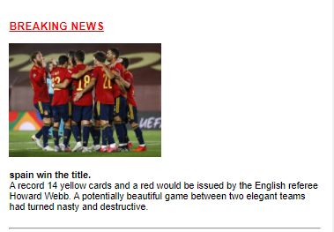

Slide 6
Development
In order to develop this web page we went threw multiple phase.
We conduct group discussion for the project and tried to list out client goals, target audience, detailed feature requests and as much relevant information as we can possibly gather.
The webpage is made responsive to for all devices.
Properties of box model are used.
Different css text formatting proterties are used

Slide 7
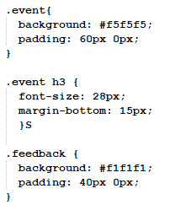

Slide 8
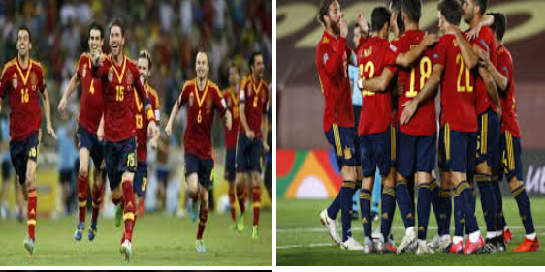

Slide 9
Conclude your project and presentation
The purpose of a website varies depending on the needs of the website owner.
It could have multi-faceted purposes with many different website goals and objectives in mind, or it could have one singular purpose and one singular purpose only.
A website is whatever the website owner wants it to be.
It could be informational, educational, divisive – you name it.
A website is essentially a platform for an individual or business to express themselves and utilize in whichever way they choose.

Slide 10
THANK YOU

